Slide 1







VITISH 2026
(SIH Internal Hackathon)
Problem Statement ID: PS-181
Problem Statement Title: An On-Device AI Companion for Personal Health Safety
Theme: MedTech
PS Category: Hardware

Slide 2
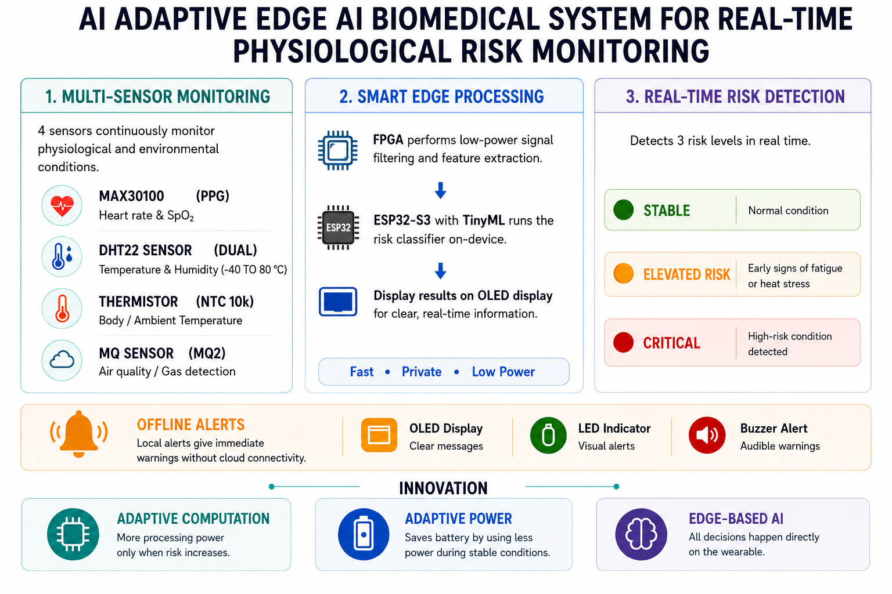

SAGE: An Adaptive Edge AI Biomedical System for Real-Time Physiological Risk Monitoring
2
Notes:
1.7.2013
2
‹#›

Slide 3

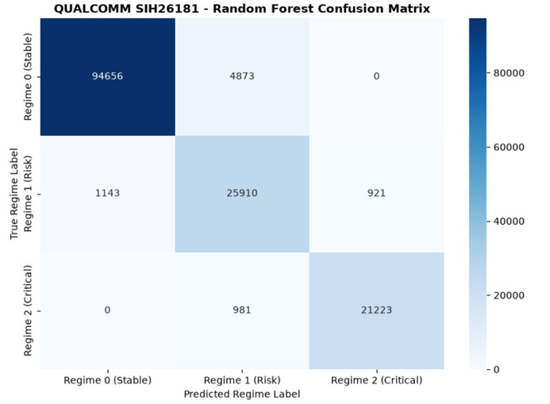
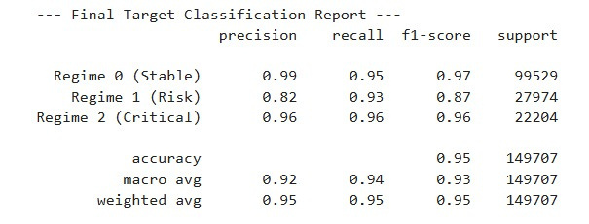
TECHNICAL APPROACH
3
Notes:
1.7.2013
3
‹#›

Slide 4
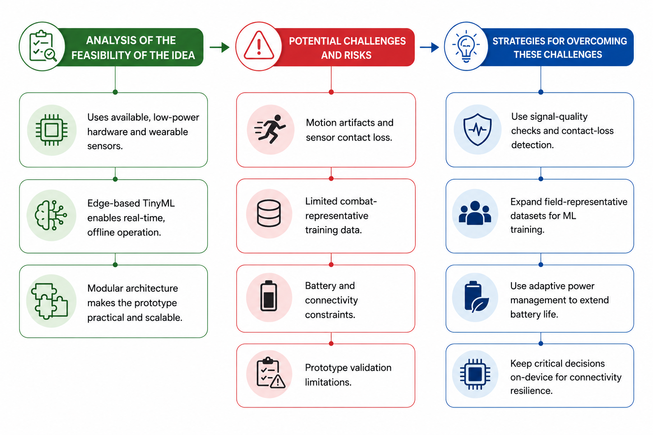

SOLUTION FEASIBILITY & VIABILITY
4
Notes:
1.7.2013
4
‹#›

Slide 5
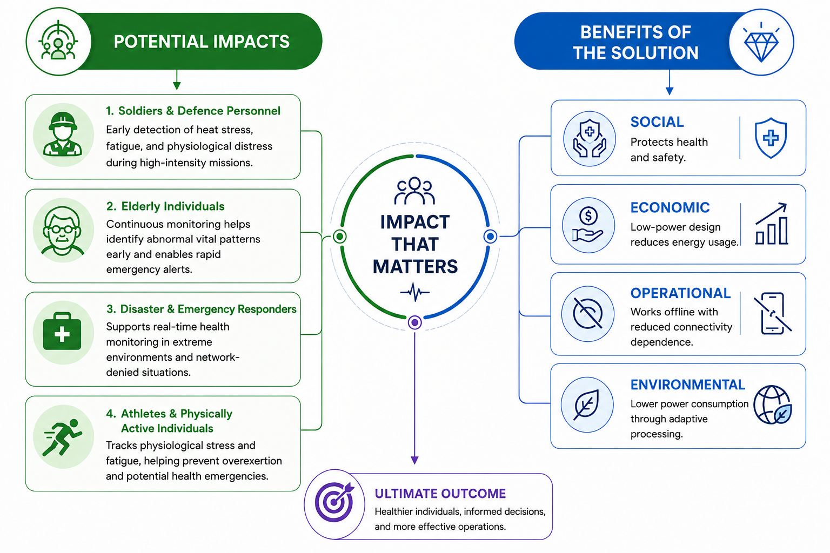
REAL WORLD IMPACTS, BENEFITS & RELEVANCE
5
Notes:
1.7.2013
5
‹#›

Slide 6
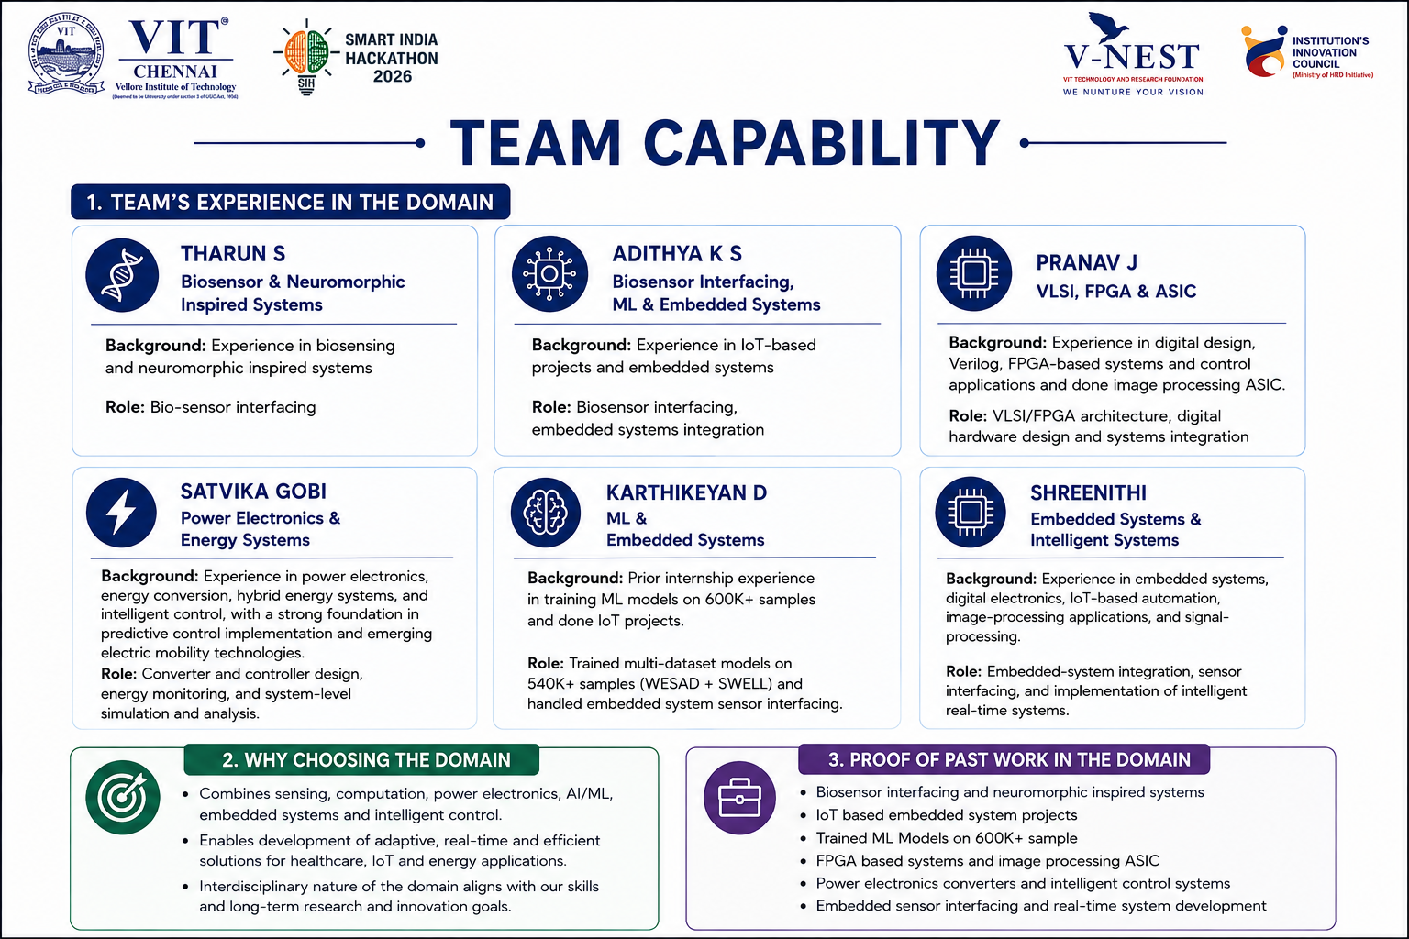
TEAM CAPABILITY
6
Notes:
1.7.2013
6
‹#›

Slide 7
RESEARCH AND REFERENCES
Buller, M. J., et al. (2021), On the real-time prevention and monitoring of exertional heat illness in military personnel, Journal of Science and Medicine in Sport, 24(10), 975–981.
→ Demonstrates the potential of wearable sensors and real-time physiological monitoring to reduce heat-illness risk in military personnel.
Zhang, J., et al. (2023), Wearable biosensors for human fatigue diagnosis: A review, Bioengineering & Translational Medicine, 8(1), e10318.
→ Establishes the use of wearable physiological sensing for continuous, portable and non-invasive fatigue monitoring, supporting our ECG, PPG and temperature-based approach.
Schmidt, P., et al. (2018), Introducing WESAD, a Multimodal Dataset for Wearable Stress and Affect Detection, ACM ICMI 2018, pp. 400–408.
→ Provides multimodal wearable data including ECG, EDA, BVP and body temperature, demonstrating the feasibility of combining physiological signals for machine-learning-based stress detection
7
Notes:
1.7.2013
7
‹#›

